Slide 1
Housing & Urban Development
Lecture # 01
“Basic Concepts”

Slide 2

Concepts of housing
Why is housing important?
?

Slide 3
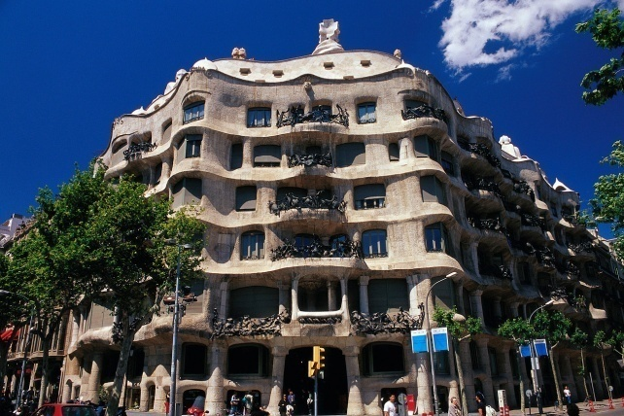
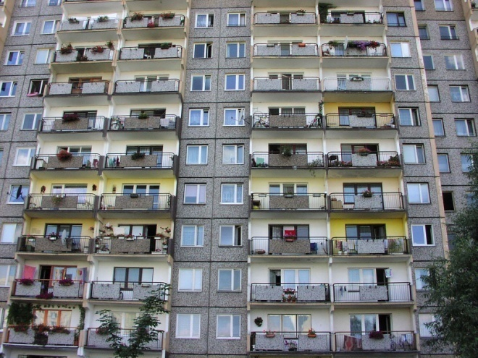
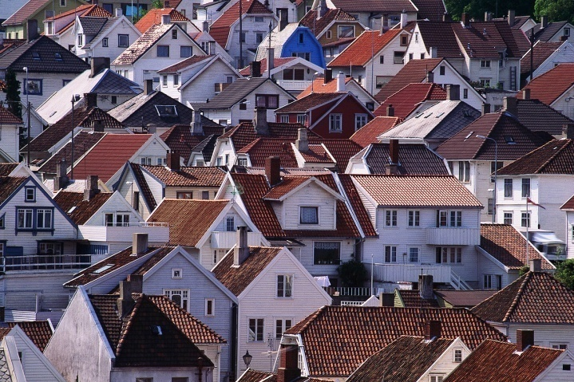
Concepts of housing
What is housing?

Slide 4
Concepts of housing
Basic concept of housing often refers to “shelter”
Housing sector: housing is a physical product of a large sector of the economy
Housing market: virtual market in which housing changes owners and occupants
Housing stock: existing housing units in a certain area of different types, not all equally accessible for everyone

Slide 5

Concepts of housing
Alternative definitions/ meanings:
  Physical product/ facility: “bricks and mortar”

Slide 6

Concepts of housing
  Commodity/ Economic good: exchange good
  Investment good: asset

Slide 7
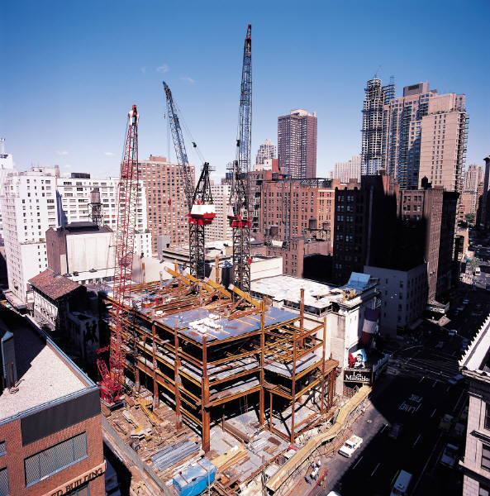
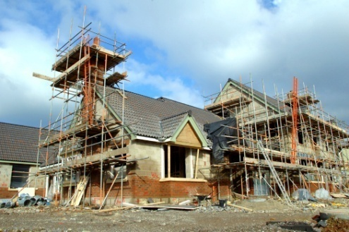
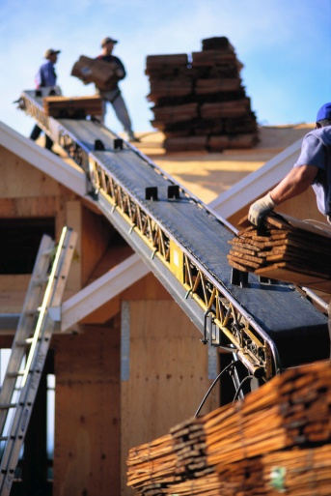
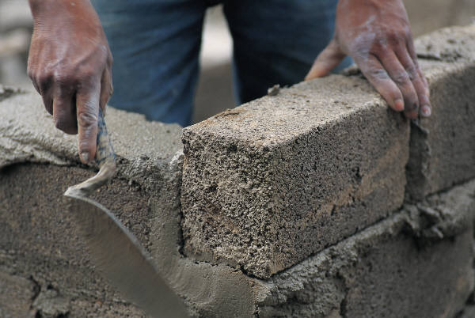
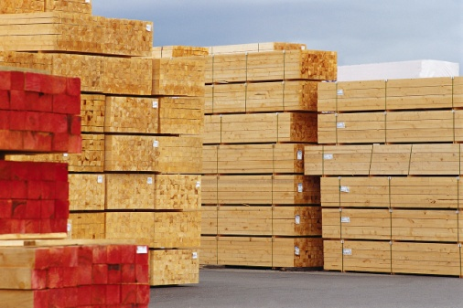
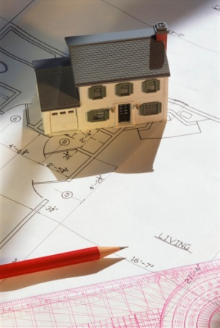

Concepts of housing
  Sector of the economy: industry/ construction

Slide 8

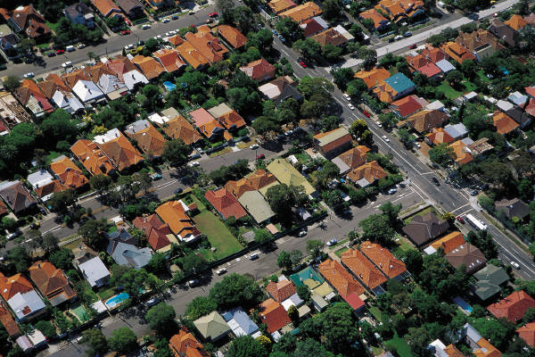
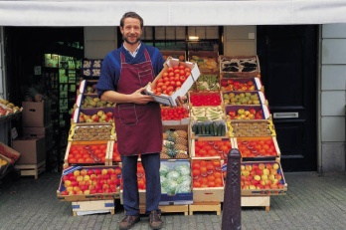



Concepts of housing
  Social/ collective good: in social networks and in consumption of services
  Building block for neighborhoods

Slide 9
Basic Terms
A house is a building that functions as a home for humans or other creatures, including simple dwellings ranging from rudimentary huts of nomadic tribes and complex structures composed of many systems.
The social unit that lives in a house is known as household. Most commonly, a household is a family unit of some kind, although households may also be other social groups or individuals.

Slide 10
Basic Terms
A home is a dwelling used as a permanent or semi-permanent residence for an individual, family, household or several families in a tribe. It is often a house, apartment, or other building, or alternatively a mobile home, houseboat, yurt, or any other portable shelter.
A homestead also includes agricultural land and facilities for domesticated animals. Where more secure dwellings are not available, people may live in the informal and sometimes illegal shacks found in slums and shanty towns
More generally, “home” may be considered to be a geographic area, such as a town, village, suburb, city, or country.

Slide 11
Defining Housing
Housing is a process that has many ingredients.
The important ingredients in the Pakistani
context include:
– land,
– infrastructure,
– building materials,
– technology and
– means of access (to housing).

Slide 12
Defining Housing
Housing generally refers to the social problem of insuring that members of society have a home to live in, whether this a house, or some other kind of dwellings, lodging, or shelter.
Many governments have a department that deals with housing, such as the Housing and Urban Development in a country, province or city. Further there are Ministry of Housing and Urban Development in general and “Ministry of Housing and Works (MOH&W)” at federal level in Pakistan.

Slide 13
Housing Amenities & Utilities
The level of the housing quality stems from the fulfillment of the basic and superior living standards within the dwelling unit, as well as the amount of complementary services, housing utilities and amenities, including health, education, shopping, working, recreation, etc.
The satisfaction of all human needs and desires represents a very wide range of factors, which must be taken into account and consequently incorporated in any design of living environment.
The creation of mixed areas with the optimal proportion of residential units, amenities, working and public spaces facilitates the design of convenient, pleasant spaces for the largest possible spectrum of users and dwellers.

Slide 14
The services delivered by housing
Access to/ occupancy of housing delivers:
Shelter from the elements
Value/ wealth → equity for owners
Shelter from ‘taxes’ → e.g. capital
Accessibility to services (e.g. schools)
Accessibility to work
Accessibility to neighborhood
Social status
Right to privacy/ exclusion
Services…
Role of location!

Slide 15
The importance of housing
Why is housing important and why is housing a unique commodity?
  High cost
  Durability
  Fixity (location)
  Limited adaptability
  Complex and diverse housing stock
  Links to services
  Imposed by government regulation
  Externalities/ exogenous influences
  Important to quality of life
  Important to self identity

Slide 16
The importance of housing
Housing is the third most essential human need after food and clothing.
Housing is related to the larger issues such as employment, transportation, health and education facilities.
Housing competes with other uses in the urban land market for accessibility and space
Housing is the principal mechanism through which urban neighborhoods change, and one of the stimulant of change in urban areas.
  Moves of households/ activities, demographic change
  New (demographic/ economic/ social/ cultural) developments
  Aging of real estate
  Fluctuations in house prices

Slide 17
Urban Development
Large cities, towns and even small neighborhoods do not spring up overnight. They are the result of careful planning by civil and design engineers, project managers, architects, environmental planners and surveyors. The integration of these disciplines is known as urban development.
Urban development is a system of residential expansion that creates cities. Residential areas are the primary focus of urban development. Urban development occurs by expansion into unpopulated areas and/or the renovation of decaying regions.

Slide 18
Urban Development
Urban planning, which is also known as urban development, incorporates planning for transportation systems and land use to improve the structure of a town or city. Urban development includes urban renewal, which addresses issues like decay and lack of investment in specific regions.
Factors like land use, aesthetics, safety, unkempt buildings and transportation all affect the urban development and planning.

